Slide 1
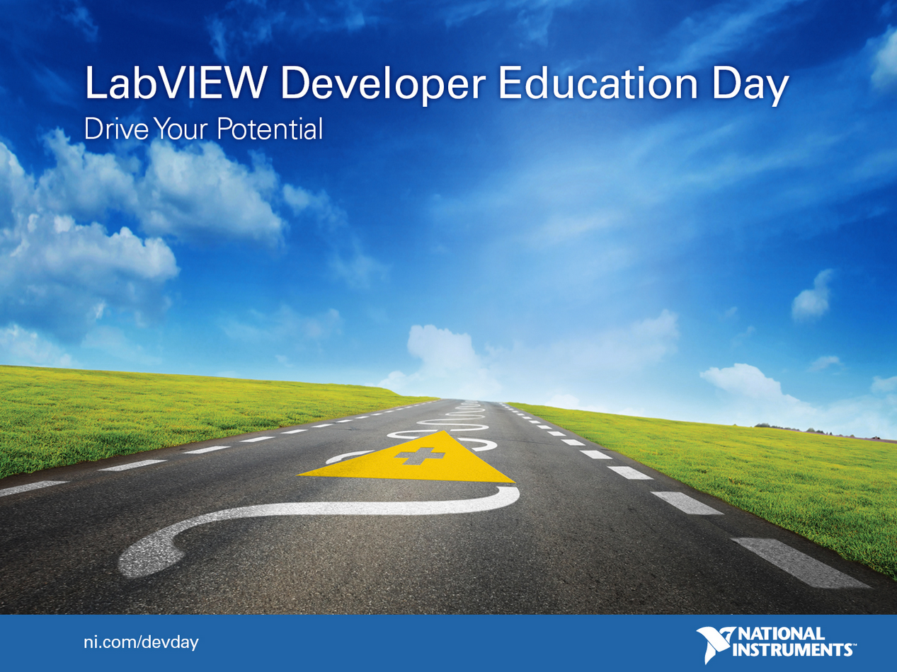

Slide 2
Using OOP in Measurement Systems
Notes:
Goal is to showcase why OOP is such an important design tool when building large systems that need to scale.
Acknowledge that OOP is a paradigm shift if you are unfamiliar with it, but the aim of this session is to make it more approachable for LabVIEW programmers by building on familiar concepts.

Slide 3
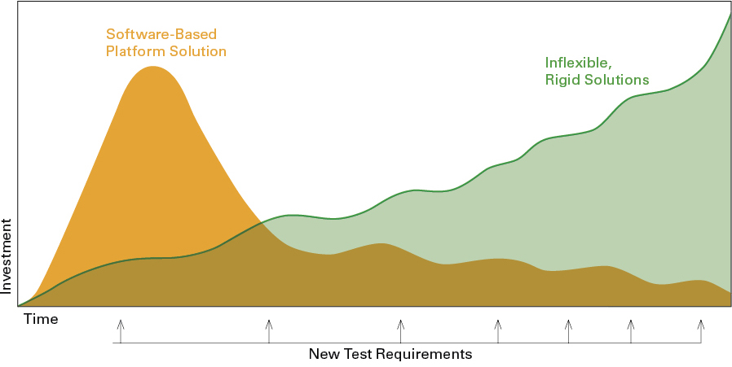
Common Problem: Software becomes difficult to maintain over time…
Initial investment in software architecture, training and processes
Notes:
We want to frame today’s discussion by examining a common life-cycle that leads to some of the problems that has developers looking for ways to write code that is easier to scale and maintain.
Green line chronicles what is probably a familiar experience to many LabVIEW programmers. At the start of the project, shown on the left side, the requirements are fairly simple and straightforward, so you just start writing code for that specific purpose. It doesn’t really require much up-front design or architecture – to be clear, this isn’t a bad thing and this is very common for LabVIEW-based systems. You can get something working quickly, perhaps acquiring a measurement, etc…
The problem is when that system needs to grow, change and adapt over time – especially over a long period of time. In this example, perhaps we’re building a test system and we have new test requirements being introduced periodically. Perhaps these require support for new hardware, new measurement capabilities, changes to the UI, etc… As we can see on the graph, each change requires an inflection point in effort, and over time it becomes extremely difficult to support and maintain this increasingly complex system. Eventually, many people arrive at a point where it becomes extremely costly and difficult to support new requirements and to make changes to the system – at this point, our code has become brittle and inflexible. Changing one seemingly innocent function breaks a bunch of other things. It is at this point that people start talking about re-writing or re-factoring code.
What we’re here to talk about: the use of OOP for extensible systems, does require more investment at the start of the project. In fact, OOP really forces developers to give more thought to their software before they start just laying down code. This is definitely a non-zero investment, especially if you and your team are new to OOP. You really need to invest in the architecutre as well as training and tools to ensure you’re doing it right.
That beings said, the entire point is that this initial investment will pay dividends over the life-cycle of the system. By investing in creating something that is scalable and maintainable, and by investing in ensuring the team has the capabilities to support the system, the effort required to build and maintain this system over time is reduced significantly.

Slide 4
Why OOP is an Answer
When you want to build scalable, extensible systems.
Translation: OOP concepts, when used correctly, decrease the risk and effort required to add functionality to an existing system. They do this, in part, by:
Minimizing the scope of changes that have to be introduced to an existing system to add new functionality
Restricting access to data to methods that have explicitly been permitted access
Making it possible to add and load new behaviors dynamically that implement existing interfaces
Enable reuse and extension of pre-existing functionality
Notes:
To be clear, OOP is just one answer, but it is a very widely adopted solution across all software languages and application areas.
One of the primary use cases for an object oriented design is to increase the extensibility of software, and it accomplishes this by addressing some of the major stumbling blocks of regular, functional programming. In particular, it creates an explicit relationship between data and methods, and thereby protects the data from unauthorized access or modifications (you’ll discuss this more later).
Objects are used via explicitly defined interfaces, which helps limit the scope of changes as they’re introduced and new functionality as added (this is a general theme to emphasize with regards to extensibility: we want to limit the impact of changes when they have to be introduced to the code base.
The 3rd and 4th bullet really speak to the benefits of inheritance. We’re able to reuse existing code by inheriting from parent classes, and we can actually override, extend and modify the behaviors of a parent class to define very specific behaviors for a child class.

Slide 5
The journey to OOP starts sooner than you think…
Configure
Acquire
Measure
Conceptually, many LabVIEW applications start with a simple, synchronous set of operations (many times all on a single diagram)
Notes:
As mentioned earlier, many LabVIEW programmers consider OOP to be a big jump that is very different from how they approach problems now. The next several slides will chronicle a very simple example of a LabVIEW measurement system that chronicles how many LabvIEW programmers start – a major point is that we’ll see that this really isn’t that far removed from object-oriented programming.
For the sake of this example, we’ll assume that we are tasked with defining a very simple measurement. At the most basic level, assume for the sake of example that we device the tasks this system needs to run into 1) Configure, 2) Acquire and 3) Measure.
We’ll use this very simplistic and abstracted view of code to examine how we go about adding changes and the impact adding those changes has on the code
[Many of the slides in this sequence should go really fast – please don’t feel that you have to spend but a few seconds on some of these slides in order to convey the point]

Slide 6
Configure
Acquire
Measure
Start Task
Read Samples
Stop Task
Savvy programmers will often use SubVIs to wrap API calls to things like device drivers or loading configuration from a file
Notes:
As you might expect, the code inside these subVIs defines how to do the specific task – as an example, the acquisition subVI is responsible for starting the task, reading the samples from the buffer and stopping the task

Slide 7
Graph
Task
Samples
DAQ Task
Clock
Raw Data
Configure
Acquire
Measure
These SubVIs typically expect certain inputs to do their jobs – many times these inputs are the output of previous operations, or a single input is shared by multiple VIs in this sequence
Notes:
We typically have a number of parameters that these function – here we some examples of those parameters: the configure method requires the task and clock – acquire needs to know how many samples to read from the buffer, and perhaps this value needs to be passed along to the measurement so that it knows how to set a window on an FFT, etc..
These data values begin to loosely define the scope of information this process requires to operate. One point that we’re going to emphasize throughout this presentation is the importance of understanding and defining ‘data scope.’
[Quick slide]

Slide 8
Measurement System
Graph
Task
Samples
DAQ Task
Clock
Raw Data
Configure
Acquire
Measure
As the application becomes more sophisticated, it’s common to want to iterate on certain tasks within a loop..
Notes:
Now that we have this simple measurement, it begins to evolve… perhaps we want to acquire continuously?
[Super fast slide – point is that our code begins to change and evolve]

Slide 9
Measurement System
Graph
I/O
Samples
DAQ Task
Clock
Raw Data
Configure
Acquire
Measure
…or perhaps the entire system
Notes:
Perhaps we want to run through the same measurement task multiple times but vary the parameters
[Quick slide – again the point is that our application is changing]

Slide 10
Measurement System
Configure Event Case
Task
Clock
Configure
Eventually, automation requires that we be able to programmatically control the order of operations and/or restart the system, which requires a state-machine-like pattern that passes data between states
Notes:
Most LabVIEW programmers eventually arrive at a point where they begin to use some of the simplest design patterns – here we see the very basic and well known state machine pattern: a case structure inside of a while loop. Each case represents a state, and the execution of that state dictates the next state.
More importantly, now we have to pass data between states, so we use shift registers..

Slide 11
Measurement System
Acquire Event Case
Samples
Raw Data
Acquire
The scope of data these operations has access to can be seen by examining the shift registers in a loop
Notes:
And we now have to pass even more data values between the different states of our state machine.
Data scope is a very important concept to consider and understand in the course of designing a process or operation. In the case of a process like this one, the shift registers on this loop define the cope of information that the functions contained in this loop have the ability to access and modify.
In general, you should strive for very cohesive data scope (meaning that things logically belong in the same process) that is decoupled from unrelated components of a system. This promotes a logical grouping of data with the methods or processes that are allowed to use that data – requiring other independent loops or processes to use defined interfaces (APIs or messages) to interact with that loop and the data it contains. Having well defined data scope also helps define where operations should be added based on what information they should have direct access to.
One of the common pitfalls that leads to brittle, inflexible code is to allow the datascope of a process or operation to grow unchecked – people often end up with a very large data scope in a single loop or process (consider a loop that combines your acquisition and your signal processing). This limits the reuse and the flexibility of the code, and increases the likelihood that a change will break something.
As we explore this system, we’ll consider some of the challenges of increased data scope and how best to mitigate them with OOP.

Slide 12
Measurement System
Measure Event Case
Graph
Measure
Notes:
[quick slide] here is the last state in our state machine for the measure method. We can now control execution order based on the output of any state and we have a clearly defined data scope.

Slide 13
Measurement System
I/O
Clock
Event Case
Samples
Raw Data
Task
As the functionality grows, so too does the scope of data. Eventually it becomes helpful to contain all of this data in a cluster, giving us a very clearly defined data-scope for this process
Notes:
Rather than maintain a bunch of shift registers for every unique value, it’s natural to cluster them together into a single data type that uses a single shift register. Now it’s much easier to determine the data scope of this loop.

Slide 14
Measurement System
I/O
Clock
Event Case
Samples
Raw Data
I/O
Task
Task
Clock
Configure
The methods within this state machine retrieve the information they need from the cluster and update values as necessary
Notes:
And as we look at these functions again, we’re simply bundling and unbundling the specific data values they need to execute.

Slide 15
Measurement System
I/O
Clock
Event Case
Samples
Raw Data
Task
Configure
Unbundling and bundling data can be encapsulated by the VI, giving the user a clean, simple top-level interface (the type definition)
Notes:
This unbundling and bundling can be encapsulated by these methods, so eventually we just pass the cluster directly in. Better yet, we make it a type definition so that we can add new parameters without making modificaitons all over our code! This is our first step towards a scalable architecture.

Slide 16
This simple illustration shows how these three operations we started with now just act upon the data within the cluster
I/O
Clock
Samples
Graph
Raw Data
Task
Configure
Acquire
Measure
These VIs are explicitly coupled to this data
Notes:
Having arrived at this point, we can simplify this state machine (assuming sequential execution) and see that we have an explicit relationship between the data cluster (ie: data scope), and the methods that are allowed to act upon that data.
These methods and the data are tightly coupled, but that data is not protected – any other VI that has access to that wire can modify the data and read the data. This may be fine for relatively simple systems, but can make debugging difficult as systems grow in size and scale.
Believe it or not, this very simple relationship between data and methods that can act upon it is the foundation for object oriented programming – this data cluster is basically an object

Slide 17
A class is basically a cluster
I/O
Clock
Measurement Class
=
Samples
Raw Data
Task
Measurement Data
A class contains data, plus
methods (VIs) that are allowed
to act upon and modify the data.
VIs that do not belong to the class
cannot act upon the data
Notes:
In fact, this cluster is effectively a class. An instance of that class is effectively an object.
The key difference is that a class contains a defined set of data, plus it defines a set of functions that are allowed direct access to this data. Anything not contained by this class must use these member functions to access the data.

Slide 18
Measurement
Graph
Configure
Acquire
Measure
The object wire can be passed into any VI that has the class on the connector pane, but only VIs that belong to the class can directly bundle and/or unbundle the data
Notes:
Returning to our simple measurement task, we can simply replace that type definition with a class. This is functionally the same as before, except only these functions (assuming they are members of the Measurement class) have access to the data on the wire. No one else can bundle or unbundle data contained on this wire.
You may often hear of this data protection mechanism as data encapsulation, especially by computer scientists.

Slide 19

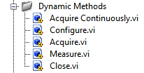
Class Data Cluster
I/O
Class constant
Clock
Samples
Raw Data
Task
Methods that can act upon the class’s data cluster
Appearance in Project
Configure
Acquire
Measure
These VIs are now owned by the class. They are transported as a cohesive library of code
Notes:
If you haven’t seen a class in LabVIEW, this shows how it’s composed in the development environment. When you create a class you generate a new .lvclass file on disk. This is similar to a library, as it is just a container – in the case of a class, this container refers to a private data control and member VIs, which are beneath the class in the tree (note they also have a new icon)

Slide 20
Demonstration
Creating a New Class
Notes:
Demo instructions:
Go through the basic mechanics of creating a class and show where the private data is defined. Give this demo only if it’s clear that most people have never seen or used OOP. Start with a basic project and create a class from scratch.
Recommendation: define a new ‘Measurement’ class and add a numeric control to define the number of samples. Don’t add any VIs at this point, but explain that you have a right-click menu where you can do this.

Slide 21
Measurement System
I/O
Clock
Event Case
Samples
Raw Data
Task
Configure
Returning to our basic system, this implementation using a clsuter effectively becomes…
Notes:
Now that we’ve seen the basics of creating a class, lets look at this system using OOP

Slide 22
Measurement System
Case
Measurement
Configure
Notes:
We essentially replace the data cluster with the object, and the VIs are then the VIs that belong to this class.

Slide 23
Measurement System
Case
Measurement
Configure
What if you want a different definition of how these methods should act?
In this example, consider the different ways in which a ‘measurement’ might be implemented
Notes:
This brings us to our first illustration of how and why OOP makes it so easy to extend an existing system. If you consider what would be required to change the behavior of this measurement, we would have to modify the contents of these subVIs and we’d likely have to add new data values to the cluster we pass into the shift register.
However, if we’re using OOP, we don’t need to do these things thanks to a capability known as inheritance – one of the most important concepts you need to understand to use classes effectively.

Slide 24
Inheritance Allows Descendant Classes to Modify, Extend and Add Functionality of a Parent
Measurement
Temp
Strain
Finite measurement of a single channel
Applies stimuli before acquiring value
These are children of the measurement class
Notes:
Given our measurement class we’ve been using in this example, we can actually create children for specific types of measurement. These children can add and even change the functionality defined by the parent without touching the parent’s code. Perhaps even more important is that they can reuse data and methods belonging to the parent.
This allows us to store functions and data that are universal across a collection of objects in a base class and add specific and unique behaviors to define specific implementations of child classes.
To be clear, Temp and Strain are children of the parent class ‘Measurement’ (also referred to as descendants). We can also refer to ‘Temp’ and ‘Strain’ as siblings of one another. We extend this analogy to grandparents, great-grandparents, etc…

Slide 25
Demonstration
Define inheritance and view the class hierarchy diagram
Notes:
Demo instructions:
Create a new class in the same project as used previously called ‘Temperature.’ Save it to disk and change the inheritance of it such that its parent is ‘Measurement.’

Slide 26
Measurement System
Case
Measurement
Configure
What if you want a different definition of how these methods should act?
In this example, consider the different ways in which a ‘measurement’ might be implemented
Notes:
Returning to the diagram we saw earlier, changing the behavior of this system is as simple as passing a new object down this wire.

Slide 27
‘Acquire’ is Dynamically Dispatched
Measurement System
Case
Temp
Acquire
Start Task
Read Samples
Stop Task
Notes:
In this case, if we pass a temperature measurement, this object has a unique data space and defines the way in which these operations should execute. This is made possible thanks to a technology known as ‘Dynamic Dispatch’
Dynamic dispatch is similar to polymorphism, but unlike polymorphism, the function selection occurs at run-time instead of edit time based on the object that is passed into the dynamically dispatched VI.

Slide 28
‘Acquire’ is Dynamically Dispatched
Measurement System
Case
Strain
Acquire
Start AO Task
Stimulate
Output
Start AI Task
Sweep Inputs
Notes:
Assuming the ‘acquire’ method is dynamically dispatched and that both Strain and Temp override it with specific implementations, we can see that this method will behave different depending upon the object we pass into it.

Slide 29
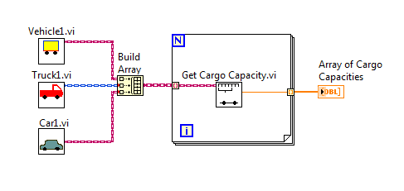



Understanding Dynamic Dispatch
Strain
Temp
Acquire
10
6
2
Resistance
Strain.lvclass:
Acquire.vi
Temp.lvclass:
Acquire.vi
Resistance.lvclass:
Acquire.vi
Notes:
In the interest of making sure dynamic dispatch is clearly understood, consider this illustration of how the acquire method for these three classes will be dynamically dispatched. Note also that we can pass sibling objects along the same wire. In fact, we can build an array of siblings. The lowest-level class that can be used as a base class will be the edit-time class of the wire.
In this case, Strain, Temp and Resistance are siblings, so the wire class will be ‘Measurement.’ If Mesurement were added to the array, it is still considered the ‘eldest’ class, so the wire type will still be ‘Measurement.’
Also of note: if a child has not overridden the definition of a dynamically dispatched VI, the parent’s definition will be run. The base class must implement the dynamically dispatched VI as well.

Slide 30
Demonstration
Illustrate dynamic dispatch
Notes:
Demo 1: (can be skipped for time)
Return to the ‘Measurement.lvclass’ and create a new dynamic dispatch method for ‘acquire’
Once you’ve done this, create a VI for override for the child ‘Temperature’ class.
Open a blank VI and drop down the Measurement class and the acquire method. Wire it in. Delete the measurement class and wire in Temp and point out that the instance of acquire that will be run has been changed. If you have time, bundle them into an array and pass them into a for loop containing the acquire method. Point out that the data type on the wire is now ‘Measurement’
Demo 2:
Open the Demo.lvproj and navigate to the block diagram of the only included VI.
Wire the different objects into the methods that are already on the block diagram to demonstrate how LabVIEW indicates which measurement's methods will be run. Make sure the audience knows which methods are overriden by children and which ones are not based on icon changes
Double-click on 'acquire' to show the dialog that is presented when editing a dynamically dispatched VI

Slide 31
Graph
Configure
Acquire
Measure
Q: Isn’t this the same thing as using case structures inside these VIs ?
I/O
Clock
Samples
Raw Data
?
?
?
Graph
Task
Configure
Acquire
Measure
Measurement Type
Notes:
Now that you hopefully begin to see how dynamic dispatch can be used, we want to clarify a few common misconceptions.
For starters, many people when learning dynamic dispatch ask the question, “isn’t this the same as just using a case structure.”
And to clarify this question, here we see two functionally equivalent systems – one using OOP and our original example. Except the original example includes case structures inside each subVI that are being driven by an enumerated constant that defines the measurement type.
So, isn’t this the same?

Slide 32
A: It’s conceptually similar, but there are extremely important differences…(NO)
To understand the difference, first consider the impact of introducing a new measurement in the non-OOP example.
3. We probably have to add new elements to this data cluster
I/O
2. We have to modify all of these VIs
Clock
Samples
Raw Data
Graph
Task
?
?
?
Configure
Acquire
Measure
Measurement Type
1. We have to add a new type to the enum
Notes:
No! If it helps, you can begin your journey towards OOP as thinking of them as similar. In fact, they will execute in largely the same manner.
The key differences are best highlighted when consider the impact of adding a new measurement to this system. One of things that makes non-OO code more brittle is the ripple caused by introduces changes to a system. Scalability is increased if we are able to isolate and contain the impact of changes to an existing systems.
In the case of the functional example shown here, there are 3 major ways in which we will likely impact this system when adding new measurements:
First and simplest of all: we will have to add a new measurement type to the enumerated constant. This alone likely modifies all of the case structures contained within each subVI. Already, we’ve introduced changes across every top-level VI in our system.
We now have to implement the measurement-specific behaviors in each sub-system. This will add a number of dependencies to the code, which may not always need to be loaded by the system. Perhaps the biggest impact of adding the new measurement capabilities is that we will likely have to increase the data scope
The data scope typically grows as we add measurements that have unique parameters or configurations that need to be stored and passed between these VIs. This becomes a slippery slope towards a giant cluster of data – only a fraction of which is relevant to the different measurements at any given point in time. Yet all of the subVIs have full access to any data element. You might find yourself wondering ‘do I set this parameter for this measurement?’ or ‘who modified this value and why?’ when trying to debug it weeks from now.

Slide 33
I/O2
As the scope of the data cluster expands, we are passing data into large segments of code inside the cases that should not have access to it. Our data is not protected
DIO
Trigger
I/O
Clock
Samples
Raw Data
Graph
Task
?
?
?
Configure
Acquire
Measure
Measurement Type
Introducing a new measurements requires changes within the VIs, as well as the calling code (sometimes referred to as a framework). This makes code very costly to maintain and brittle
Notes:
This last point is worth emphasizing. A common code ‘smell’ (a colloquialism many programmers use to refer to a clear sign that something is not written well) is a giant data cluster. This goes back to the original point about data scope – if the scope of data that is included in this cluster is not a logical grouping (consider for example that you have ‘thermocouple type’ next to ‘strain bridge type’ – no measurement would likely ever need both of these), then you might need to consider alternatives that would improve the scalability of code.
Large data clusters often become very brittle, difficult to debug and maintain.

Slide 34
Sibling Classes Have Unique Data Scope
Task
Data that every measurement needs to have
I/O
Samples
Measurement
Thermocouple
Bridge Type
excitation
Strain
Temp
Data unique to these specific measurements, plus ‘exposed’ data of parent measurement
Notes:
Alternatively, classes each have their own unique data scope, even though sibling objects can travel down the same wire.
In this example, we can see that the measurement class includes data values that are universal to every measurement in this system – it includes a task constant, an I/O parameter, and the number of samples that should be acquired. (emphasize that this is an abstract example – you can imagine in reality perhaps a hierarchy of measurements of a similar nature).
Both the Strain and Temp measurements would need all of the data values defined by ‘Measurement,’ but they also add their own unique and specific data values. A temp measurement needs to know what type of thermocouple it’s using, where a strain needs to know the excitation source and the bridge type.
The temp measurement cannot access or modify the excitation source of the strain measurement – conversely, a strain measurement never has access to (nor would need) to define the type of thermocouple to use.

Slide 35
One of the biggest differences: this new functionality has to be added at edit time.
What if you want to load a new measurement into your calling system at run-time?
I/O2
DIO
Trigger
I/O
Clock
Samples
Raw Data
Graph
Task
?
?
?
Configure
Acquire
Measure
Measurement Type
Yes, you can dynamically load the VIs called by these VIs, but you have to have pre-defined the data they have access to. The data in the cluster wire cannot be changed at run-time, as the connector pane must match exactly.
Notes:
Another very big difference between OOP and functional programming is how flexible a calling framework can be. As an example, if we want to add a new measurement to the functional code shown here, we need to do so at edit-time.
With classes, we can add a new object at run-time. We can even load a new object into memory after execution has begun.

Slide 36
At edit-time, LabVIEW shows us the wire of the parent class we have said will be passed along this wire (in this example: Measurement.lvclass)
Graph
Configure
Acquire
Measure
Notes:
You can see this at edit time when using classes too. If you simply replace the object wired into these functions, the wire will now be that specific type of class, and the methods will display the icon of the appropriate methods.

Slide 37
We may pass any child of this class down this wire at run-time. Dynamically dispatched methods will execute the copy belonging to the run-time instance.
?
Graph
Configure
Acquire
Measure
LabVIEW can load a new child at run-time. The class will bring its methods and it’s data cluster into memory when loaded. This makes it possible to add functionality without modifying calling code. The code to load a child class is referred to as a Factory.
Notes:
However, people increasingly want to create a plugin architecture, which allows the addition of a new class that implements a pre-existing parent interface at run-time.
A class that we load into memory at run time can have a unique data scope and can define new implementations of dynamic dispatch VIs – none of this needs to be known by the calling framework ahead of time.
Loading a new child class at run-time is typically done using a standard pattern known as a ‘factory pattern.’

Slide 38
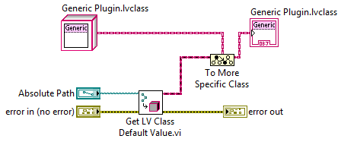


The Basics of an Object Factory
A
B
Objects Loaded Into Memory
C
Generic Measurement
← Parent
Location on Disk
Where Measurements Classes are Stored
A
B
C
← Children
Notes:
It’s a very simple pattern – in fact this is the heart of the pattern. The ‘Get LV Class Default Value’ VI is pointed at a location on disk and loads a new object into memory. You need to tell the compiler what type of object to expect in order to utilize the interface for that object – you do this using the ‘to more specific node.’ Using this node, you wire in the parent class of the object that will be loaded. If it is a valid child, the child class will be passed out. If not, an error will be returned.

Slide 39
Group Exercise
“About that ‘Graph’ output… what if my measurements output different data types?”
Strain
Graph
Configure
Acquire
Measure
Temp
X
Boolean
Configure
Acquire
Measure
Dynamically dispatched VIs must have the same connector pane. You cannot have a different data type output on ‘Measure.’ So how do we solve this problem?
Notes:
At this point we’ve looked at data encapsulation, inheritance, and dynamic dispatch, so you should have a basic understanding of all the fundamental building blocks for object oriented programming.
So lets try a simple group exercise. Lets continue with our previous example and imagine that we have the two measurements we’ve discussed before: Strain and Temp. Assume we have overridden the dynamically dispatched methods for ‘configure,’ ‘acquire,’ and ‘measure.’ One of the first stumbling blocks people often encounter is that they either need to supply or receive a unique value to or from this measurement. To keep it simple, lets consider how you return the measured value from this object, especially if the Temperature and Strain measurements will return different values.
Given what you know now – how could you go about designing this system?

Slide 40
Q: How can an instance of the measure method return information that is appropriate and specific to the measurement class it belongs to?
Consider the following requirements:
We have to pass different data-types at-run time out of the measure method
We always know a specific measurement will return a certain type of data
We need to be able to display that data to a user in an appropriate format
We need to pass the data back to a framework that implements a pre-defined interface for operations like ‘dispaly,’ ‘save,’ etc…
?
Measure
Is a variant a valid solution?
We can pass any data-type on a variant wire
How do we know how to display the data on a variant wire to a user?
If we pass the variant to our calling code, how will it know how to save it to disk or display it to the user?
Notes:
Highlights from the slide: we know a measurement will always return a specific type of result. According to this, requirements include that a result may need to be displayed in a manner that is specific to the data (think about the fact that there’s a relationship between data and methods that act upon that data). This type of approach is common when building a framework that needs to call a standard interface that is capable of displaying and doing different things.
A variant is not the answer we’re looking for, though it can be used. It risks creating code that is not easily scaled, as you have to add logic to ensure data is cast to the appropriate type at run-time. We might then drive behaviors like ‘display’ based on the data-type, but this becomes difficult to extend over time.
In this scenario, consider the use of a class hierarchy that represents the result of a measurement.

Slide 41
Use a Class Hierarchy
Measurement Result
Defines methods all results should be able to define, such as ‘Save,’ or ‘Display’
Strain Result
Temp Result
Resistance Result
Each has a unique private data cluster to store the result of a measurement and defines how that data is stored or displayed using dynamically dispatched methods that override the interface defined by the parent ‘Measurement Result’
Notes:
Consider for example a class hierarchy that derives different results from a base definition of what a result should be able to do (ie: ‘Save,’ ‘Display,’ etc…)
Each measurement definition might be coupled to a class represent the result, which would encapsulate the data we want to return and define methods for displaying and interacting with the data.

Slide 42
General Best-Practice: Don’t Use Variants
Variants are typically used when different types of data have to travel down a single wire. Anytime you feel the need to do this, consider replacing the wire that would be a variant with a class hierarchy.
Why? Classes still enforce strict data-types at edit-time, thereby ensuring no run-time errors. Variants do not, and therefore increase the likelihood of run-time errors.
Notes:
In general, variants are to be avoided if you care about scalability. They are a quick and simple way to enable passing arbitrary data down a wire, but they are susceptible to run-time errors because they do not enforce strict data-typing. This can lead to errors that can be difficult to pin-point.
Heavy use of variants is another use of a ‘code smell.’

Slide 43
All measurements will need to use hardware.
Measurement Class
Configure
Acquire
Measure
But I’d like to..
run the same measurement class on different machines, which have different hardware
continue development on a machine with no access to hardware
be able to add a new device of a certain type without modifying the measurement
Notes:
For the last section of this presentation, lets take what we know about OOP and this very abstract measurement definition and consider how this measurement might interact with real hardware.
Consider that we want to be able to write a measurement knowing the types of hardware it will use, but perhaps not knowing the specific devices that will be available. As an example, we know we need a DMM, but we don’t know if it’ll be a PXI 4070 or an Agilent 34401 – it might even be simulated.
This all relates back to extensibility because we also need to be thinking about how we support hardware in the future – hardware that may not even exist yet!

Slide 44
A measurement is defined assuming certain classes of devices are available, but without knowing exactly which instrument.
In this example, this measurement strategy uses a DMM. It assumes an instance of a DMM implements a pre-defined interface, without knowledge of how that interface is implemented
Temp
Configure
Acquire
Measure
DMM Class
Configure
Current
Source
Autozero
Read
Notes:
In this case, we have our temperature measurement which needs a DMM. In order to acquire we need to implement the method using the generic interface for a DMM, but we won’t know until later which DMM we want to use.

Slide 45
DMM Class
Agilent 34401a
PXI-4070
Simulated DMM
Notes:
So, we create our first very simple hardware abstraction layer. We define a generic interface for a DMM and later create children that wrap specific driver calls. The use of inheritance in this example allows us to use the same measurement strategies on different systems without even touching the code!

Slide 46
Other measurements may require different classes of hardware, or perhaps multiple devices (ie: stimulus/response measurements), but we can’t change the connector pane of methods we want to override (like Acquire.vi).
Measurement Class
Configure
Acquire
Measure
?
The objects passed along this wire must all be children of the same parent class
Notes:
Here’s where it gets tricky: other measurements may need other types of devices. They may need a DMM, a SCOPE, an ARB, a FGEN, etc…, but remember that the connector panes we defined as the interface for these methods have to be identical for any and all measurements.
As shown here, all of the devices passed into the acquisition method have to have the same parent class, but consider that different devices will use different interfaces.

Slide 47
Measurement Class
All measurements use an array of hardware
Configure
Acquire
Measure
But different classes of hardware would definitely not implement the same interface
Notes:
In this scenario, one solution is to derive all of our devices from a common ‘Hardware’ class that implements almost no functionality. The only likely function that is common across all devices is a simple method that returns what type of instrument a device is.
Having this common base object will allow us to pass in an array of different devices to any measurement, but not all of these objects implement the same interface.

Slide 48
Sample Hardware Class Hierarchy
Hardware
Power Supply
DMM
Scope
Generator
PXI-4110
Simulated
Simulated
34401a
PXI 4070
Simulated
PXIe-5185
Simulated
Notes:
In this example, we have a base class: ‘Hardware,’ and children for each classification of device we expect the system to use. It is at this intermediate layer that we define the interfaces for these types of devices, and the leaf-level classes (or grand-children) implement the interfaces by calling directly into the device driver.
Consequently, the only work necessary to add support for a new device is to add a new leaf-level class – no calling code in the framework or in parent classes needs to be modified!

Slide 49
Measurement Class
Methods can cast hardware objects to specific children at edit-time using the ‘to more specific’ primitive
Configure
Acquire
Measure
DMM
SCOPE
The dark blue wire can be passed into the interfaces for the specific device classes
Notes:
The final concept that needs to be understood for this example to work is that the measurement needs to specify to the compiler the type of interface that will be expected.
If we have an array of different devices the wire’s data type will be ‘hardware.’ We cannot wire the hardware wire into one of the specific interfaces unless we explicitly tell the compiler that an object will implement a specific interface. To do this, we need to cast the wire at edit time to one of the intermediate level classes – we do this using the ‘to more specific’ primitive, which accepts the generic hardware wire as an input, as well as the class that defines the interface we will use. Having done this, the wire that comes out on the right will have the type of the intermediate class and can thereby by used with the appropriate interface.
If an incorrect device type is passed into this method, it will return an error.

Slide 50
Demonstration
Use these concepts in a real system
Notes:
Part 1
Return to the Demo VI used in this previous example
Open the instance of 'Acquire' that is implemented by the Diode IV class. Use this block diagram to illustrate how the to more specific note tells the compiler which interface will be used to implement this measurement
Part 2
Open and run the main.vi subVI that is on the block diagram: this launches the framework that is used to illustrate calling and using these measurements - as well as how devices are passed to them. Implementation is not a part of this demo, this just illustrates the concepts in use.
Point out how this has loaded the measurements we just looked at along with a variety of different devices
Emphasize that the list of measurements shown here can be added and changed at run-time thanks to the use of the factory pattern
Select diode form the list and illustrate how you can pass concrete devices to it at run time

Slide 51
Summary of Most Important Concepts
Always be thinking about data scope – keep it cohesive and small
Classes create define data scope and a set of functions that are allowed access to data
Consider using a class hierarchy to replace a massive data structure
Dynamic dispatch allows child classes to override a parent’s method and reuse others
Dynamic dispatch occurs at run-time, whereas polymorphism occurs at edit-time
Use parent classes to define the interfaces children should implement
If you find yourself using a lot of variants, consider a class hierarchy
And finally, classes are not as big of a leap as you might think – we hope you agree after this presentation!

Slide 52
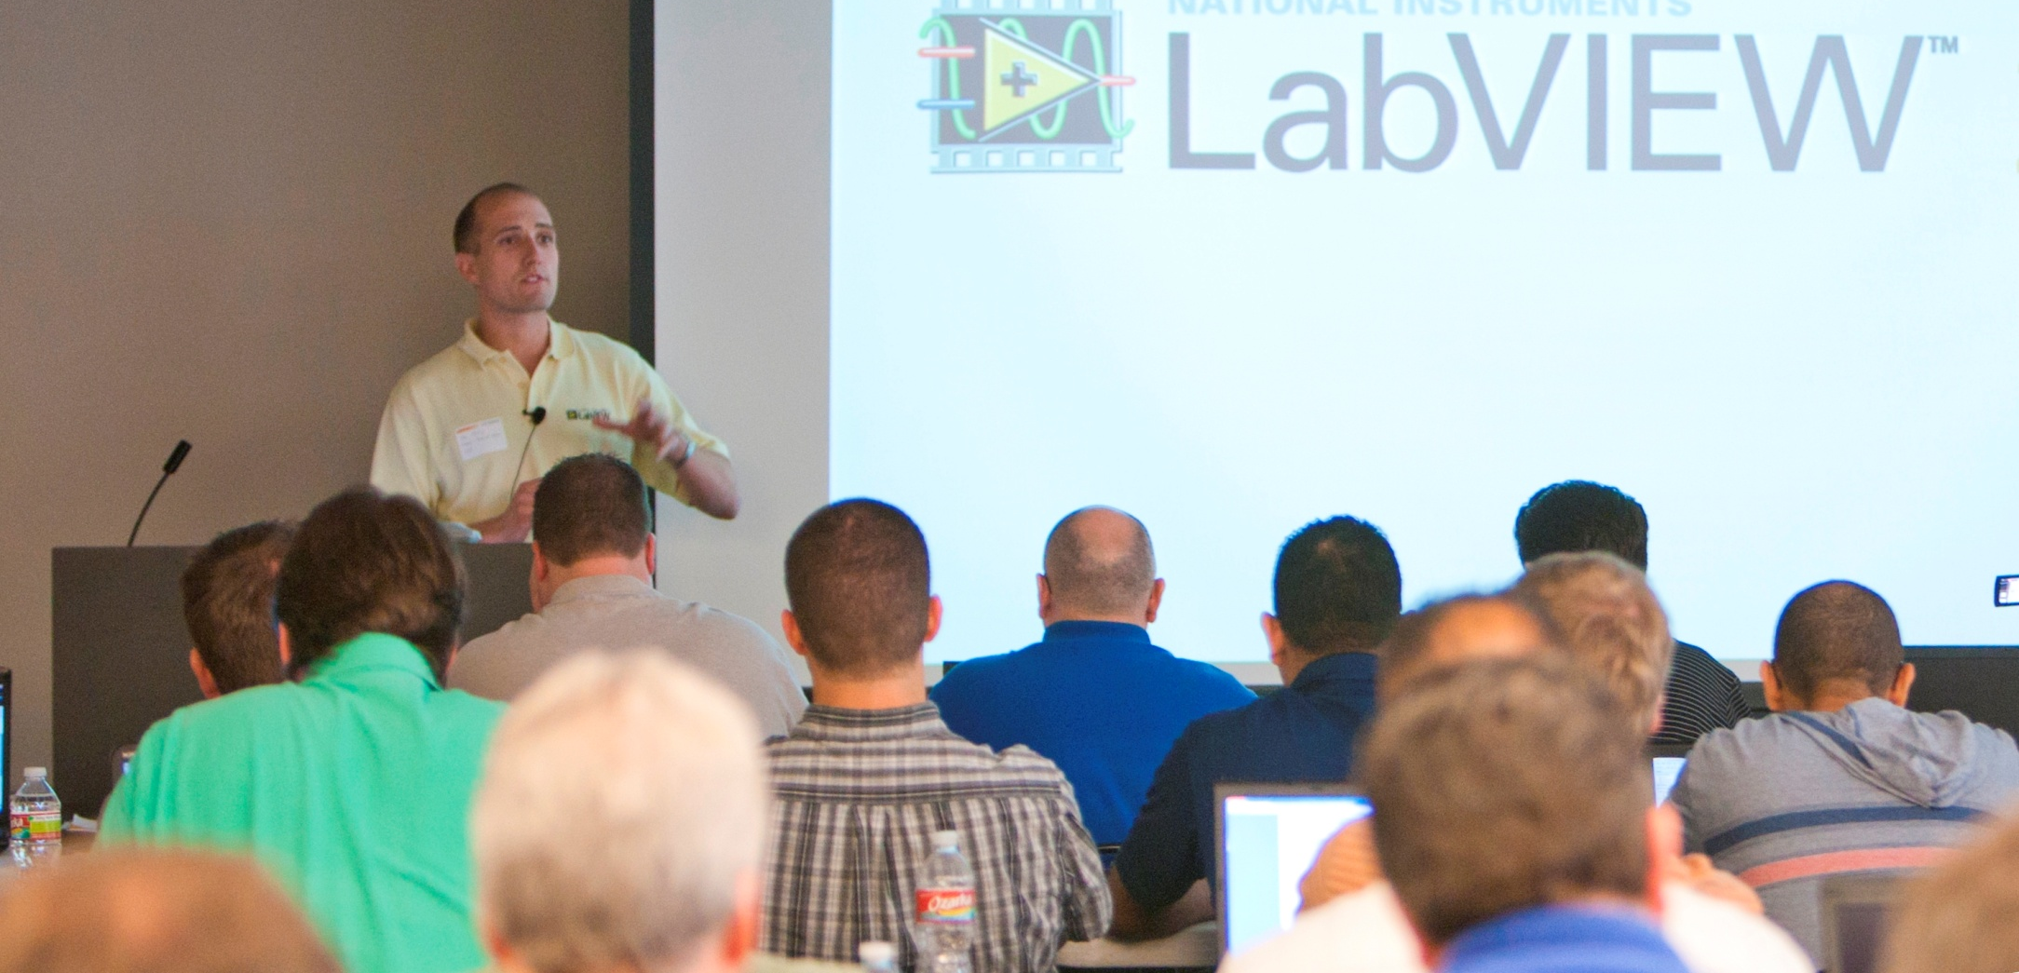
Want to Learn More?
Trained LabVIEW Users reported developing 50% faster and spending 43% less time on maintenance
The Object-Oriented Design training course is available Online!
Visit ni.com/training/self-paced to learn more
Prefer a live instructor?
Find a classroom course near you at ni.com/training

Slide 53

Join the 10,000 + NI Certified Professionals
Validate your skills and differentiate yourself from your peers with NI certification.
In a worldwide survey, Certified LabVIEW Developers (CLD) reported:
…as a result of NI Certification
Start preparing now at ni.com/training/certification_prep
Email certification@ni.com
To Schedule Your Exam
Notes:
Certification Makes a Difference.
Professional certification is a proven way to boost your career potential. Certification helps inspire confidence in technical skills and demonstrates familiarity with and proficiency in a skill area, as well as knowledge of best practices in that area. The NI LabVIEW professional certification program offers you the ability to demonstrate your skills and differentiate yourself.
A survey of CLDs found:
Over 54% said the quality of their work improved
Nearly 45% said their peers’ perceptions of them improved
Nearly 30% got new project opportunities
Visit ni.com/training/certification_preparation for exam preparation guides, sample exams, break downs of the most missed concepts
Visit ni.com/certificationschedule or email certification@ni.com to register for an exam near you.

Slide 54
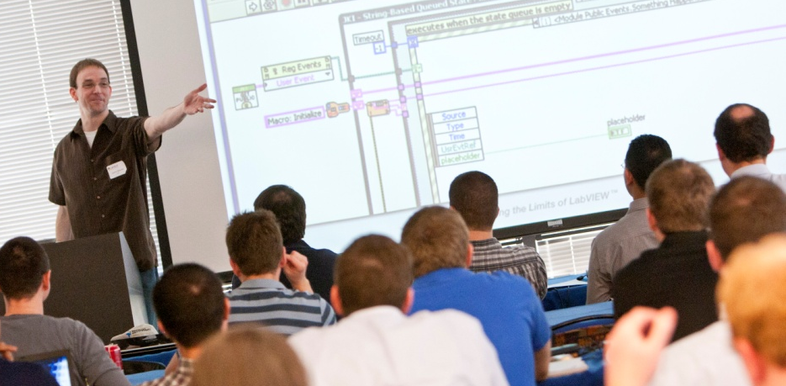
Looking for More?
Attend a CLA or CLD Summit to:
Network and exchange best practices with other certified professionals and NI engineers
Participate in highly technical presentations
Get exclusive opportunities to meet with NI developers
Take the recertification exam for free
Learn more at ni.com/cla-summit
You must be certified to attend a Summit. Email certification@ni.com to register for an exam near you.
Notes:
Audience 1/3 Certification
Each spring, National Instruments hosts the Certified LabVIEW Architect (CLA) Summit in the United States and Europe. The event brings together some of the world’s best NI LabVIEW programmers to discuss architectures, preview new features, and network with other CLAs and members of NI R&D.

Slide 55
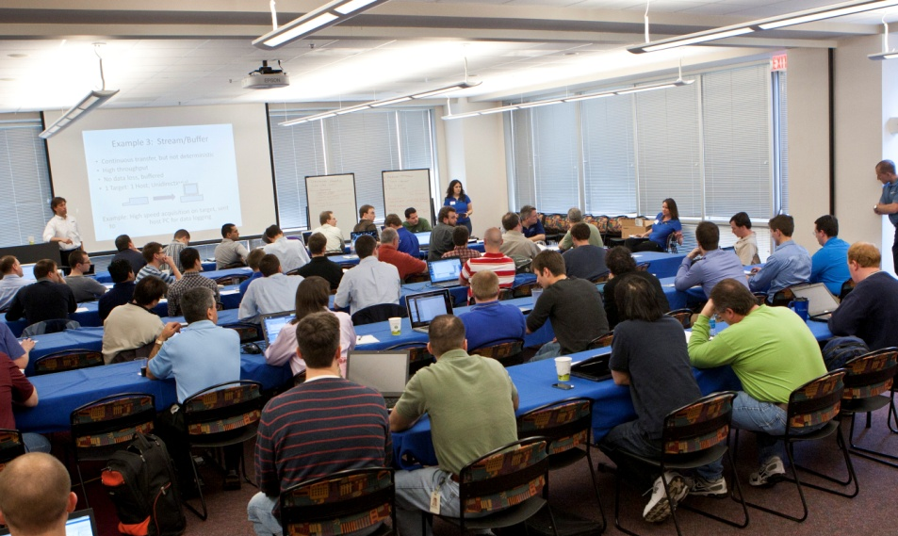
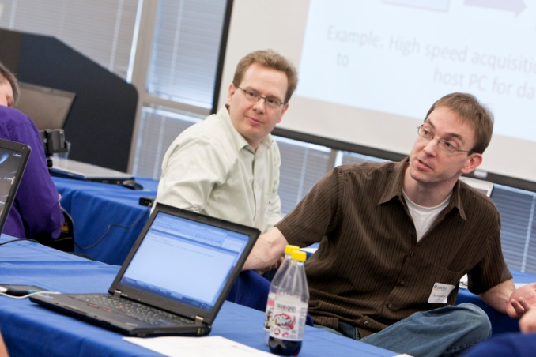
Missed the CLA Summit this year? Get certified for next year!
The Certified LabVIEW Architect (CLA) Summit brings together some of the world’s best NI LabVIEW programmers to discuss architectures, preview new features, and network with other CLAs and members of NI R&D.
Learn more at ni.com/cla-summit
Email certification@ni.com to register for an exam near you.
Notes:
Audience 1 Certification
Each spring, National Instruments hosts the Certified LabVIEW Architect (CLA) Summit in the United States and Europe. The event brings together some of the world’s best NI LabVIEW programmers to discuss architectures, preview new features, and network with other CLAs and members of NI R&D.

Slide 56
Already CLAD Certified?
You’re immediately eligible to take the Certified LabVIEW Developer exam. Start preparing now!
Join a local user group
Prepare using resources on Developer Zone ni.com/training/certification_prep
Time yourself during practice exams
Note: CLAD certification must be current to take the CLD exam
Email certification@ni.com to register for an exam near you.

Slide 57
